Slide 1

Clinic Database Design
Group 5:
Kuo Zhao
Sri Satya Arumilli
Shree Vaishnavi Reddy Bhoomi Reddy
Pooja Regadda
Seshi Reddy Syamala

Slide 2
The Database Structure
Design for Clinic
Including general procedure
Representative

Slide 3
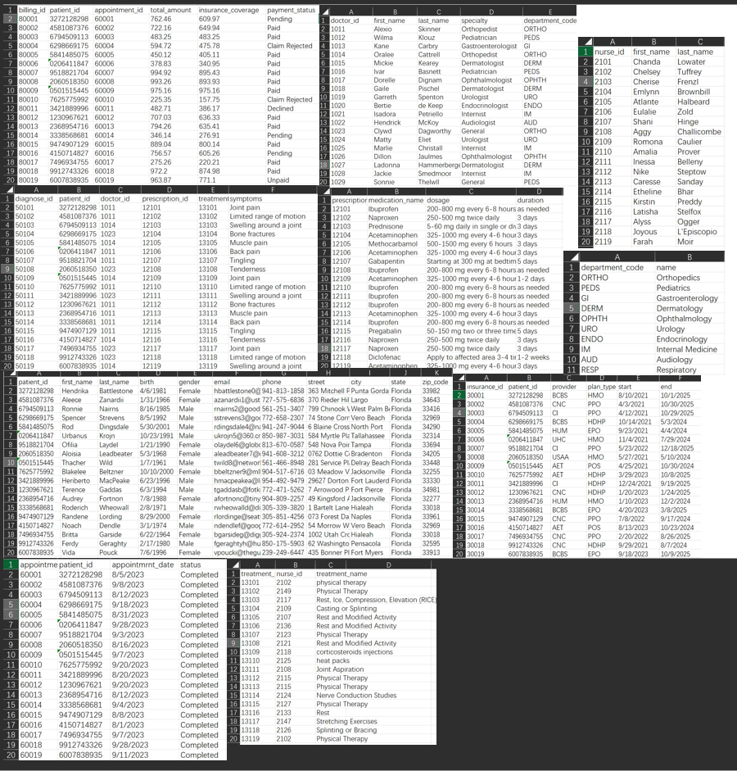
Data Loading
Utilized MocKaroo to generate sample Data
1500 rows: Patients, Appointments
1000 rows: Diagnoses, Prescriptions, Treatments, Billing, Insurance
51 Nurses; 32 Doctors; 10 Departments

Slide 4
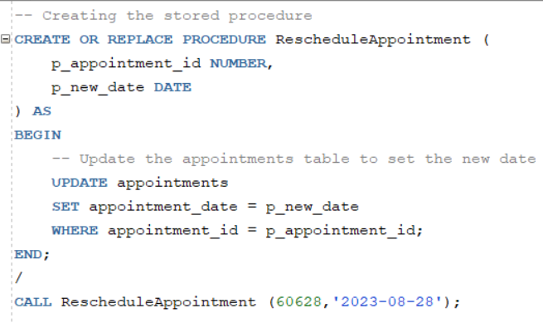
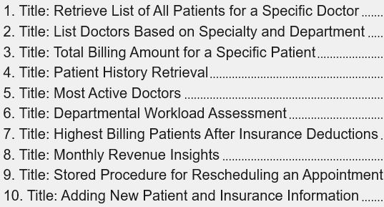
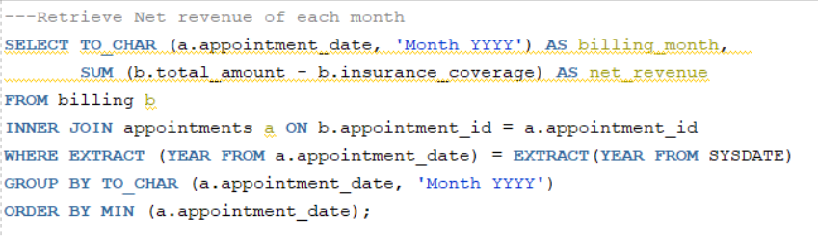

Develop Queries
Example: Stored Procedure for Rescheduling an Appointment
Other Queries:
Example: Monthly Revenue Insights

Slide 5
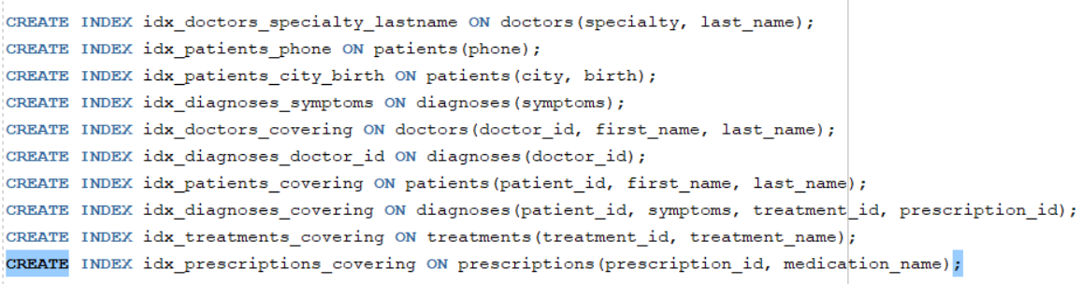
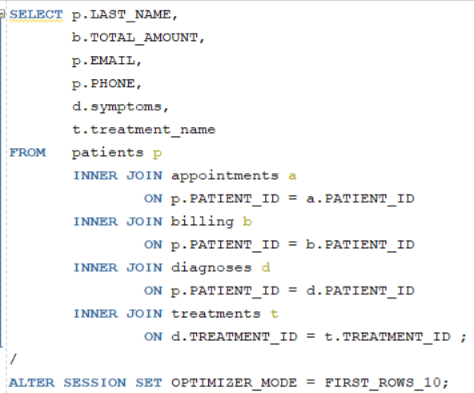
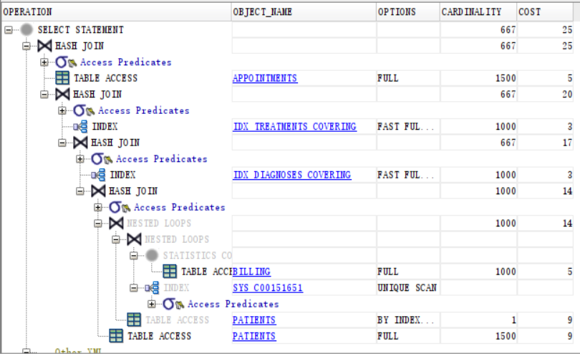
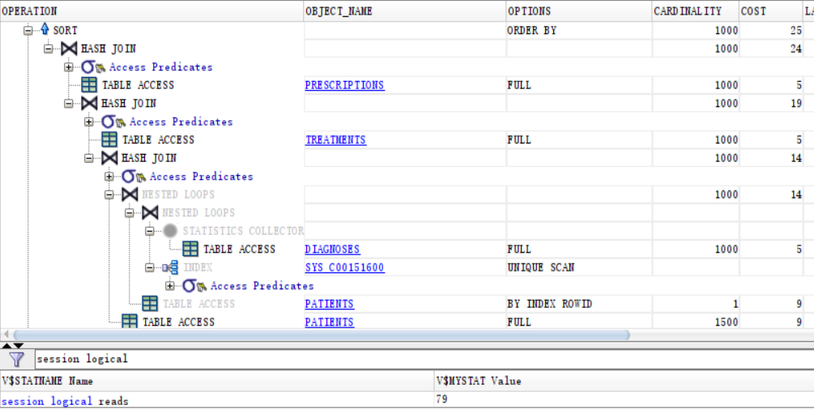
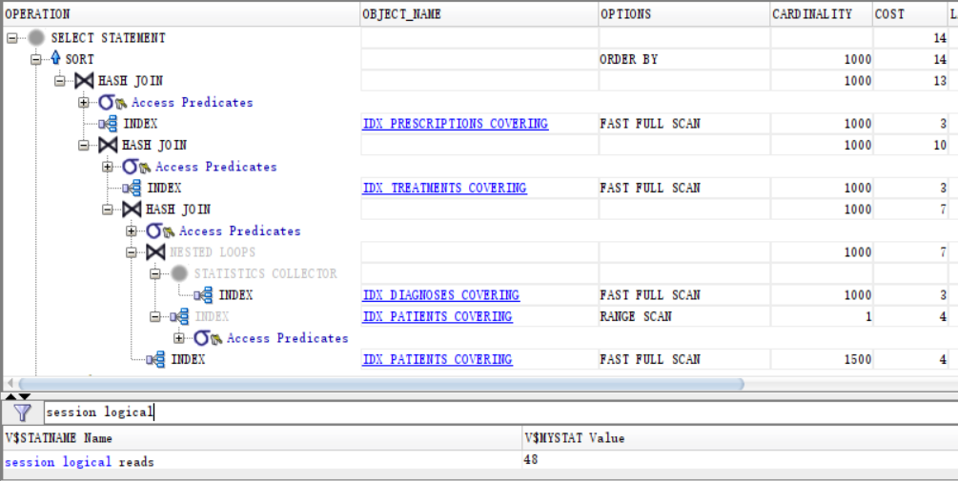
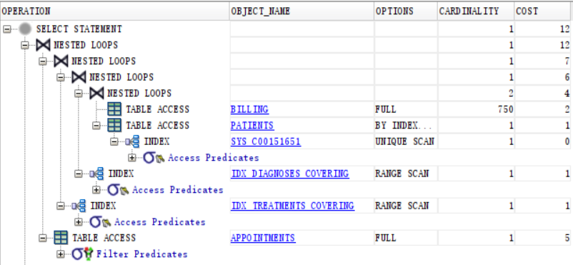
Performance Tunning
Indexing strategies
Optimizer changes
Increasing Performance:

Slide 6
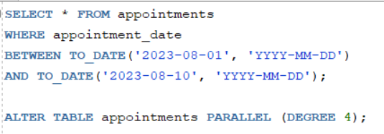
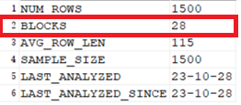
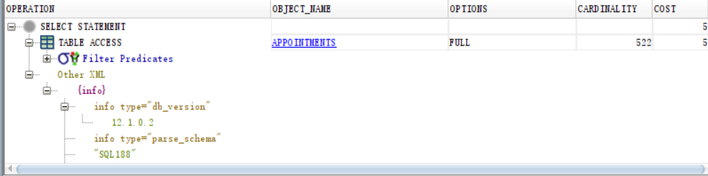
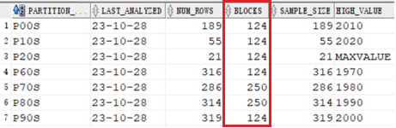
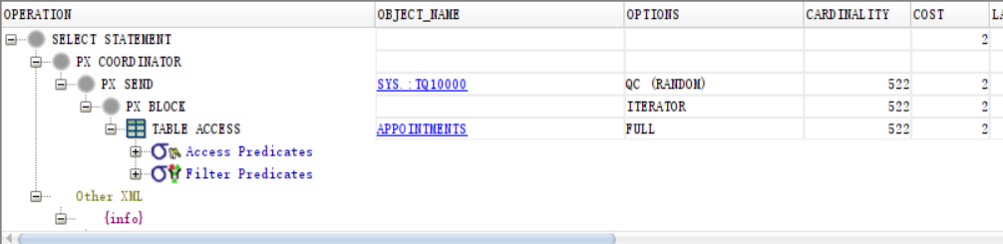
Performance Tunning
Table partitioning
Parallel Execution
Patients table
Before:
Partition table
After:

Slide 7
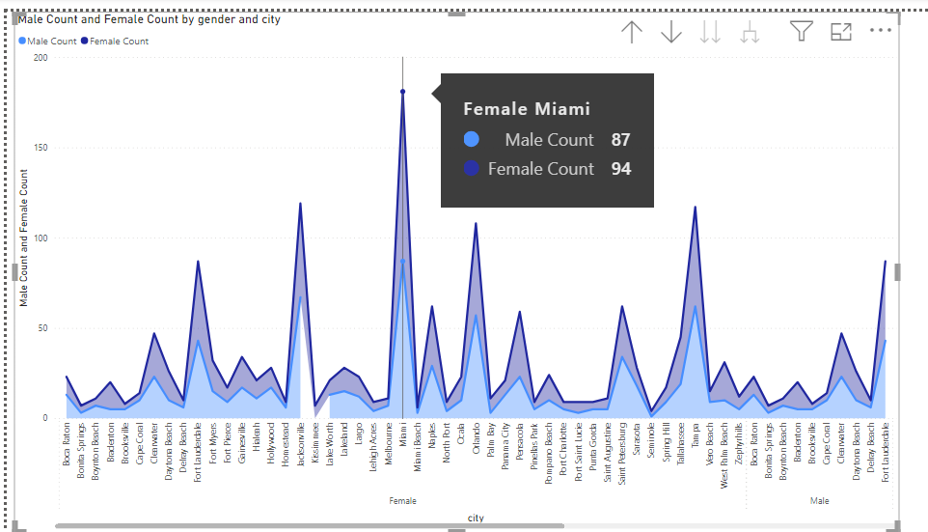
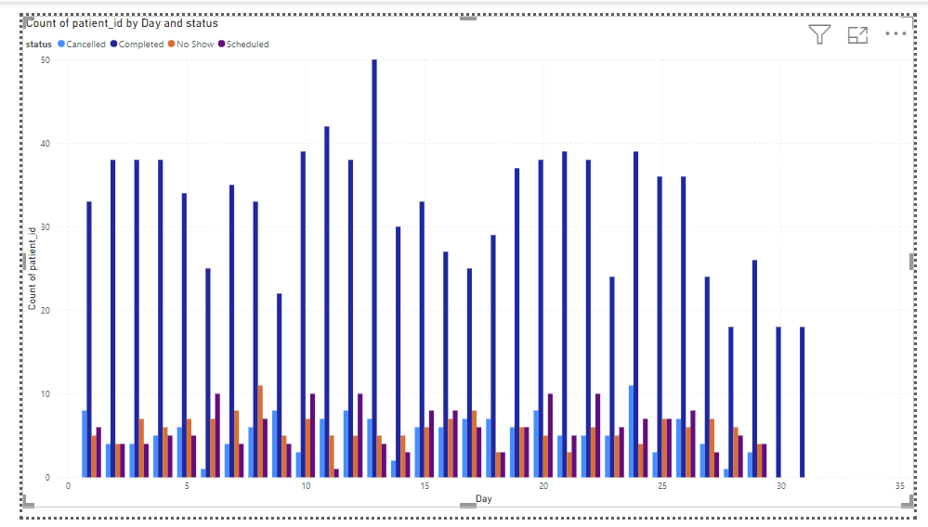
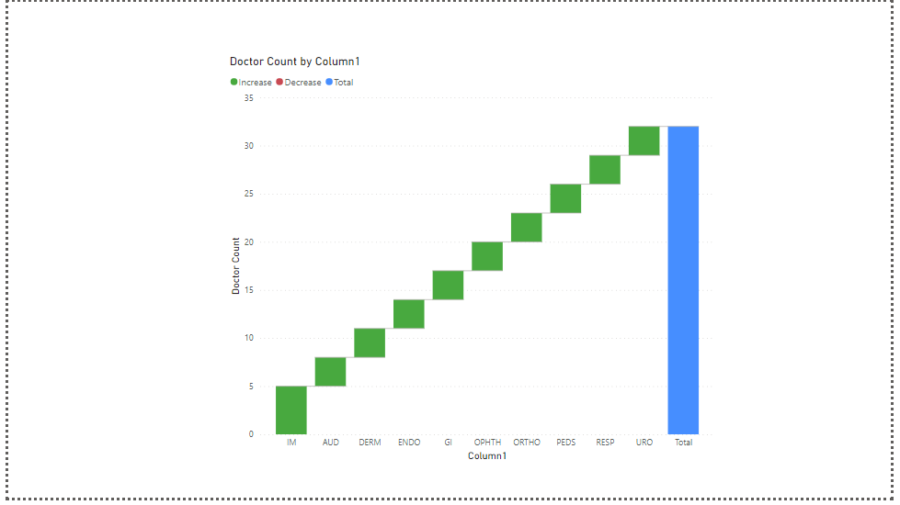
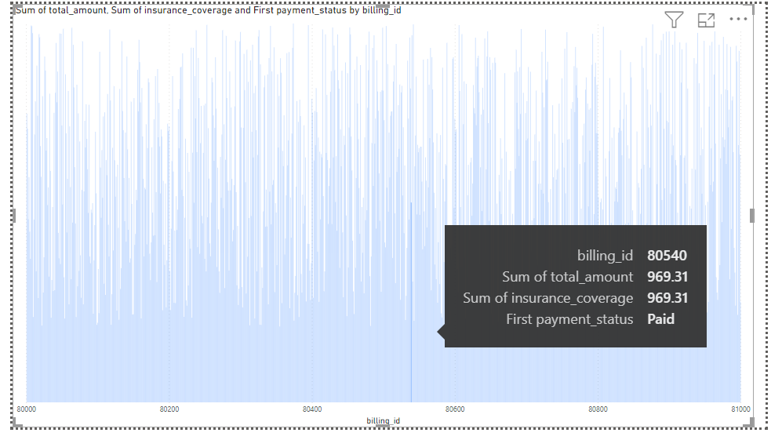
Data Visualization
Gender Demographics Analysis in Florida Cities
Doctor Distribution Across Specialties
Appointment Status Distribution by Day
Insurance Coverage vs. Total Bill Amount

Slide 8
Thank You!

